Slide 1
50.003: Elements of Software Construction
Week 6
Thread Safety and Synchronization

Slide 2
Plan for the Week
What are thread safety?
data races
correctness
How to ensure atomicity
Atomic variables
Race conditions
check-then-act and lazy initialization
Locking
Intrinsic locks and reentrancy
How to ensure objects are shared correctly

Slide 3
Example
Write a program such that N threads concurrently increment a static variable (initially 0) by 1. Set N to be 100, 1000, 10000 and see what is the value of the variable after all threads are done.
FirstBlood.java

Slide 4
Is This Real?
Thread1
Thread2
0
0
00
count = 0
count++
count++
➔
count = 1
01
10
count = 1
1
1
11
count = 2
This is assuming that count++ is one step. Or is it?

Slide 5
Reality is Messy
Java Programs
Bytecode
What are the atomic steps?
JVM
What are the order of execution?
Physical Machine
What and where are the variable values?

Slide 6
What Really Happened?
Thread1
Thread2
0
0
read value of Count and assign it to a register
read value of Count and assign it to a register
1
1
Increment the register
Increment the register
2
2
Write the register value back to Count
Write the register value back to Count
3
3
For double type, even read/write is not atomic!

Slide 7
What Really Happened?
Thread1
Thread2
00
r2
r1
0
0
01
10
r1
r2
i2
i1
1
1
02
11
20
w2
w1
i1
i2
03
12
21
30
2
2
r1
r2
w1
w2
13
22
31
3
3
i1
i2
23
32
w1
w2
33

Slide 8
What Really Happened?
Thread1
Thread2
00
r2
0
0
01
10
r1
r2
r1
1
1
02
11
20
i2
i1
i2
03
12
21
30
2
2
i1
w1
w2
13
22
31
w1
3
3
23
32
w2
count=1
33
Is this correct?

Slide 9
Specification
What is correct depends on what we want
class invariants
pre-condition/post-condition
assertions
Do document the specification!
See a sample class: Stack.java

Slide 10
What Really Happened?
Post-condition: count’ = count+2
00
r2
r1
01
10
Thread1
Thread2
i2
i1
0
0
02
11
20
r1
r2
w2
w1
03
12
21
30
1
1
r1
r2
i1
i2
13
22
31
2
2
i1
i2
23
32
w1
w2
w1
w2
3
3
33

Slide 11
No Sharing = No Race Condition

Slide 12
Constants => No Race Condition

Slide 13
How to Ensure Atomicity
Weapon 1:
Package java.util.concurrent.atomic
Example:
AtomicInteger x = new AtomicInteger(0)
x.incrementAndGet() //increments x by 1 atomically
Operation A and B are atomic with respect to each other if, from the perspective of a thread executing A, when another thread executes B, either all of B has executed or none of it has. An atomic operation is one that is atomic with respect to all operations, including itself, that operate on the same state.

Slide 14
Cohort Exercise 1 (5 min)
Fix the program you developed in Cohort Exercise 1 using AtomicInteger, assuming the post-condition is that the sum is the number of additions.
FirstFixWithAtomicInteger.java

Slide 15
Compound Actions
//withdraw from a bank account
//check and update
if (amount >= 1000) {
amount = amount - 1000;
}
SecondBlood.java

Slide 16
Intrinsic Locks
Every Java object can implicitly act as a lock for purposes of synchronization.
synchronized (lock) {
//Access shared state guarded by lock
}
Intrinsic locks acts as mutexes (mutual exclusion locks), i.e., at most one thread may own the lock.
Since only one thread at a time can execute a block of code guarded by a given lock, the synchronized blocks guarded by the same lock execute atomically with respect to one another.

Slide 17
How Lock Works
Thread1
Thread2
0
0
acquire lock
acquire lock
1
1
r1
r2
2
2
i1
i2
3
3
w1
w2
4
4
release lock
release lock
5
5
SecondBloodFixed.java

Slide 18
Cohort Exercise 2 (10 min)
Assuming that the correctness requirement is that “saving + cash = 5000” is an invariant, fix the following class: LockStaticVariables.java. Hint: Think about what is the lock?
LockStaticVariablesFixed.java

Slide 19
Thread Safety
If an object of type A is to be shared by multiple threads, A must be thread safe.
“A class is thread-safe if no set of operations performs sequentially or concurrently on instances of a thread-safe class can cause an instance to be in an invalid state***.” Java Concurrency in Practice, Chapter 2
*** whether a state is valid or not is defined by the specification
Stateless objects are always thread-safe

Slide 20
Guarding States with Locks
Update related state variables in a single atomic operation
For each mutable variable that may be accessed by more than one thread, all assesses to that variable must be performed with the same lock held.
Every shared, mutable variable should be guarded by exactly one lock. Make it clear to maintainers which lock that is.
For every invariant that involves more than one variable, all the variables involved in that invariant must be guarded by the same lock.
ThirdBlood.java

Slide 21
Cohort Exercise 3 (15 min)
CachedFactorizer.java provides a service to factorize integers. For efficiency, it stores the last input and its factors so that in case the new input is the same as the last (a.k.a. a hit), the saved factors are returned. It also counts the number of hits and maintains a hit ratio. Fix the class so that it becomes thread-safe.
CachedFactorizerThreadSafe.java

Slide 22
Safety and Efficiency
Why not declare every method synchronized?
Probably not efficient. Example, CachedFactorizer.java
Do not guarantee thread-safety. Example,
if (!vector.contains(element)) {
vector.add(element)
}
Thread A
L | service | U
Thread B
L | service | U
Thread C
L | service | U
More on performance later

Slide 23
Cohort Exercise 4 (10 min)
Continue cohort exercise 4 so as to narrowing the scope of the synchronized block, without compromising thread-safety.
CachedFactorizerThreadSafe.java

Slide 24
Lock-Ordering Deadlock
public class LeftRightDeadlock {
private final Object left = new Object ();
private final Object right = new Object ();
public void leftRight () {
synchronized (left) {
synchronized (right) {
doSomething();
}
}
}
public void rightLeft () {
synchronized (right) {
synchronized (left) {
doSomethingElse();
}
}
}
}
Thread A
Thread B
lock left
lock right
try to lock right
wait for lock left
wait forever
wait forever
More on deadlock later

Slide 25
Reentrancy
When a thread requests a lock that is already held by another thread, the requesting thread blocks.
public class widget {
public synchronized void doSomething () {
…
}
}
public class LoggingWidget extends Widget {
public synchronized void doSomething () {
System.out.println (toString() + “: calling doSomething”);
super.doSomething();
}
}
Is this a problem?

Slide 26
Wait and notify
Week 6

Slide 27
Thread Control
Method | Remarks
start() | Causes this thread to begin execution; the Java Virtual Machine calls the run method of this thread.
Thread.yield() | A hint to the scheduler that the current thread is willing to yield its current use of a processor.
Thread.sleep(long millis) | Causes the currently executing thread to sleep (temporarily cease execution) for the specified number of milliseconds, subject to the precision and accuracy of system timers and schedulers.
wait() | Causes the current thread to wait until another thread invokes the notify() method or the notifyAll() method for this object.
notify() | Wakes up a single thread that is waiting on this object's monitor.
notifyAll() | Wakes up all threads that are waiting on this object's monitor.
join() | Waits for this thread to die.
interrupt() | Interrupts this thread.

Slide 28
wait()
Busy waiting is not efficient
Consider a voting system with two threads. One collects votes and the other is waiting to count the votes when the voting is completed.
while (true) {
synchronized(this) {
if (votingComplete) {
break;
}
}
}
Use wait()/nofityAll() to avoid busy waiting
Voting.java

Slide 29
Cohort Exercise 5 (15 min)
Producer/Consumer Pattern
Exercise: fixed the Buffer class in BufferExample.hava so that it is thread-safe and efficient
BoundedBuffer
Producer Thread 1
Producer Thread 2
…
Consumer Thread 1
Consumer Thread 2
…
addItem
removeItem
BufferFixed.java

Slide 30
Synchronization
Week 6

Slide 31
Example
Initially A, B, r1 and r2 are all 0.
What are the values of the variables after both threads complete?
Is it possible to have B = 1 and r2 = 2 and A = 2 and r1 = 1?
Thread 1 | Thread 2
1: r2 = A; | 3: r1 = B;
2: B = 1; | 4: A = 2;

Slide 32
Reality is Messy
Java Programs
Bytecode
What are the atomic steps?
JVM
What are the order of execution?
Physical Machine
What and where are the variable values?

Slide 33
What are the order of execution?
Java compiler might switch the order of sequential statements (e.g., for efficiency)
Example: line 2 and line 3 might be switched
1. x++;
2. y++;
3. x++;
How could we know the order of execution?
Self-read: Java Memory Model

Slide 34
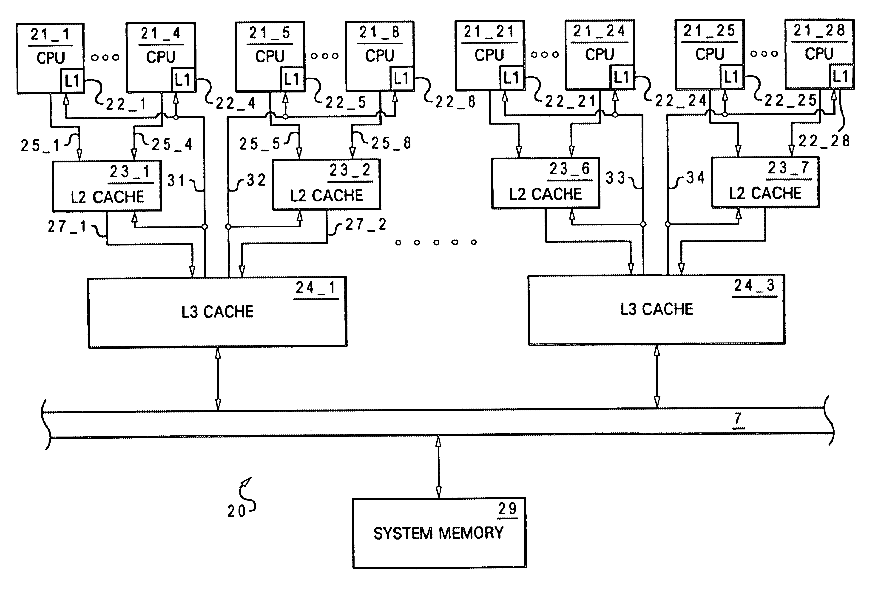
Where are the variables stored?
old ready
new ready
How could we know where?
FactorThread.java; NoVisibility.java

Slide 35
Remedy
Visibility guarantees for synchronization
Always use the proper synchronization whenever data is shared across threads.
thread A
…
…
…
Everything before unlock on M
…
unlock M
lock M
… is visible to everything after
the lock on M
…
…
…

Slide 36
Example
What is the problem here?
public class MutableInteger {
private int value;
public int get() { return value; }
public void set(int value) { this.value = value;}
}
public class MutableInteger {
private int value;
public synchronized int get() { return value; }
public synchronized void set(int value) { this.value = value;}
}

Slide 37
Locking and Visibility
Locking is not just about mutual exclusion; it is also about memory visibility. To ensure that all threads see the most up-to-date values of shared mutable variables, the reading and writing threads must synchronize on a common lock.

Slide 38
Volatile Variables
An update to a volatile variable is propagated predictably to other threads.
Locking can guarantee both visibility and atomicity; volatile variables can only guarantee visibility.
private static volatile boolean ready;
…
while (!ready) {
Thread.yield();
}
…

Slide 39
Cohort Exercise 6 (5 min)
Fix Experiment.java with volatile.
ExperimentFixed.java

Slide 40
Summary
We have so far learned how to write basic multi-threaded program and how to guarantee thread-safety for simple classes.

